Slide 1
ETL – An Overview

Slide 2
What is ETL ?
ETL Stands for Extract – Transform – Load
Process of Data loaded from one source to another source
Extract data multiple sources to build a Data Warehouse, Data Hub, or Data Lake.
Used to migrate data from one database to another
An important part of today's business intelligence (BI) processes and systems.

Slide 3
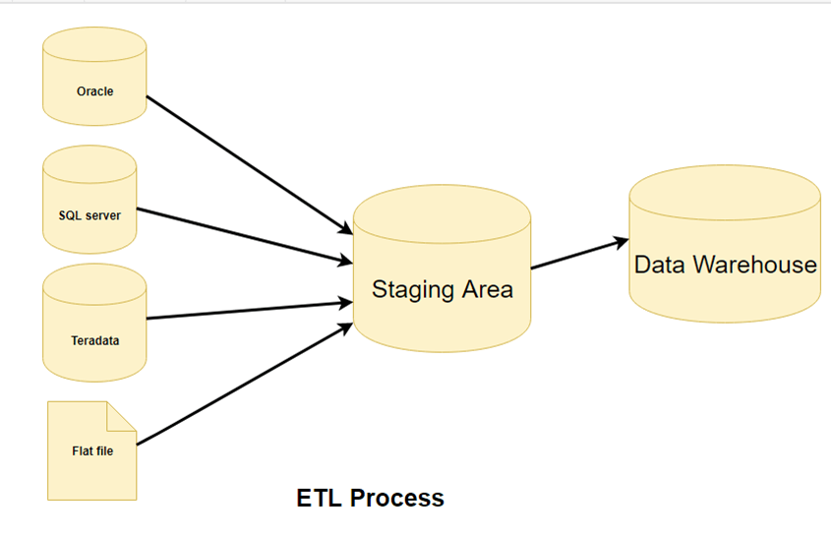
ETL Process
A basic ETL process can be categorized in the below stages:
Data Extraction
Data Cleansing
Transformation
Load

Slide 4
OLTP
On-Line Transactional Processing Database
Designed for real time business operation
OLTP uses traditional Database Management system
Insert, Update, and Delete information from the database.
Must maintain data integrity constraint
It will respond in millisecond
Will have detailed and organized
Complete back up of data combined with incremental backups
Example- online banking, online ticket booking system

Slide 5
OLAP
On-Line Analytical Processing Database
Different OLTP databases become the source of data for OLAP.
Tables in OLAP database are not normalized.
OLAP uses the data warehouse.
Characterized by Large volume of data
helps with planning, problem-solving, and decision support.
OLAP only need a backup from time to time. Backup is not important compared to OLTP
Help to Increase productivity of the business analysts.

Slide 6
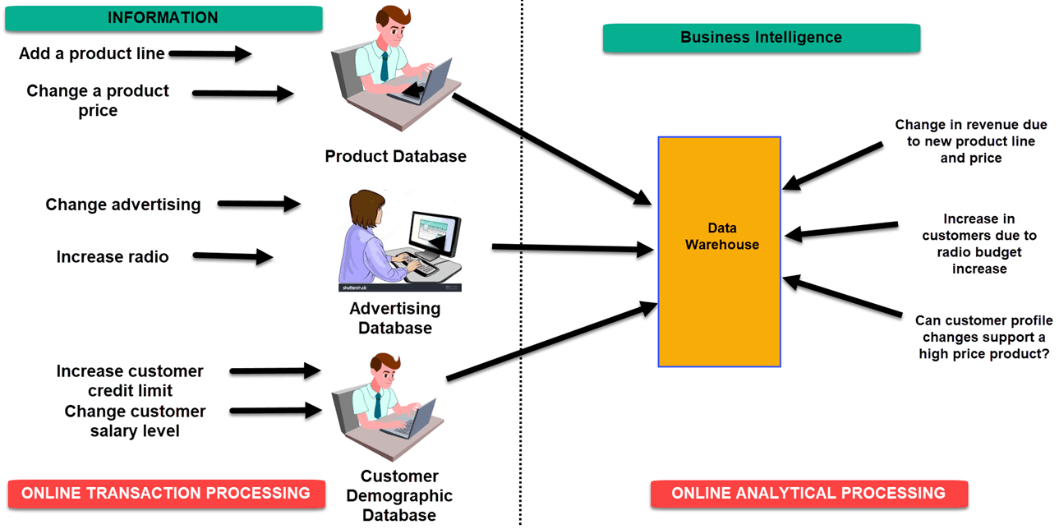

Slide 7
Data Modelling techniques
Dimensional Data model
Facts
Measurements/facts
Foreign key to dimension table
Dimensions
provides the context surrounding a business process event.
Who – Customer Names
Where – Location
What – Product Name
dimensions are joined to fact table via a foreign key.

Slide 8
Need for ETL Testing
Transformation of Data extraction would result in human error or system error
Poor information conveyed across Enterprise
Allows verification of data transformation, aggregation and calculations rules.
Allows sample data comparison between source and target system
ETL Testing ensures
Data Completeness
Data Correctness
Data Integrity
Data Reconciliation
Data Transformation
Data Quality
Performance and scalability of system

Slide 9
ETL Tools
Popular ETL Tools available in Market
Informatica Power Center
Ab Initio
IBM Infosphere Data stage
Microsoft SSIS
Oracle Data integrator
SAP – Business Object Data integrator

Slide 10
Skill required:
SQL
Data analysis
basic Unix scripting
good to know Data warehousing concepts i.e. star schema, Facts, dimensions
Any ETL tool Informatica, data stage, Ab initio, Talend etc.
PL/SQL is also needed based on the application

